Slide 1
Full Stack Web Development
HTML / Getting Started
https://github.com/adithya72/UIDevelopment

Slide 2
What Is HTML?
HTML is a markup language for creating web documents / pages
Hyper Text Markup Language
Markup language – Uses a set of markup tags
NOT a programming language

Slide 3
HTML Tags
HTML tags define HTML elements which is an individual component of an HTML document or web page.
Keywords surrounded by angle brackets
<p>This is a paragraph element surrounded in paragraph tags</p>

Slide 4
Page Structure
<!DOCTYPE html>
<html>
<head>
<title>My Webpage</title>
</head>
<body>
<p>This is my first web page</p>
</body>
</html>

Slide 5
Page Structure
<!DOCTYPE html> - Declaration defines this document as HTML5
<html> - Describes an HTML document
<head> - Provides information about the document
<title> - Provides a title for the document
<body> - Describes the visible page content

Slide 6
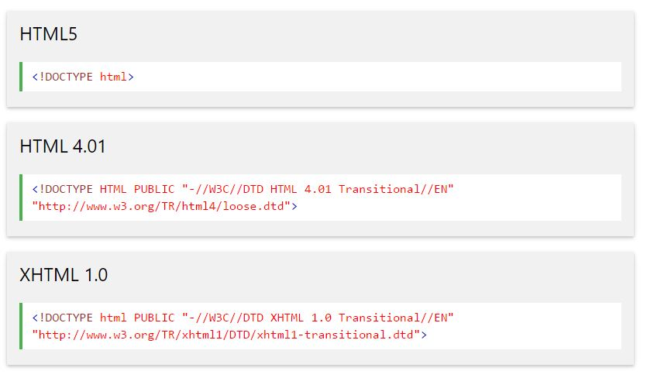
Common Doctype Declarations

Slide 7
Closing Tags
Not all tags have closing tags like <p></p>
Some tags can close themselves
Line-Break Tag - <br>
Self Closing Line-Break Tag - <br /> (Remnant of XHTML)

Slide 8
Common Tags
Paragraph <p>
Headings <h1> - <h6>
Link <a>
Image <img>
Unordered List <ul>
Ordered List <ol>
List Item <li>
Table <table>
Form <form>
Input <input>
Button <button>
Lin Break <br>
Horizontal Rule <hr>
Division <div>
HTML <html>
Head <head>
Body <body>
Strong <strong>

Slide 9
Attributes
Tags can also have “attributes” which include extra bits of information about that tag/element. Attributes appear in the tag inside of quotation marks
<tag attribute=“value”></tag>
<a href=“http://google.com”>Click</a>
<h1 id=“myHeading”></h1>

Slide 10
Block Level Elements
Always starts on a new line
Takes up full available width
<div>
<h1> - <h6>
<p>
<form>

Slide 11
Inline Level Elements
Does not start on a new line
Takes only width necessary
<span>
<a>
<img>

Slide 12
Creating A Web Page
Use a text editor or IDE to create your HTML document
Add elements, tags, attributes, etc
Save file with a .html extension
Open it up in a browser – No server needed

Slide 13
Resources
- https://github.com/adithya72/UIDevelopment
- https://www.w3schools.com
-

